Slide 1
LECTURE 5

Slide 2

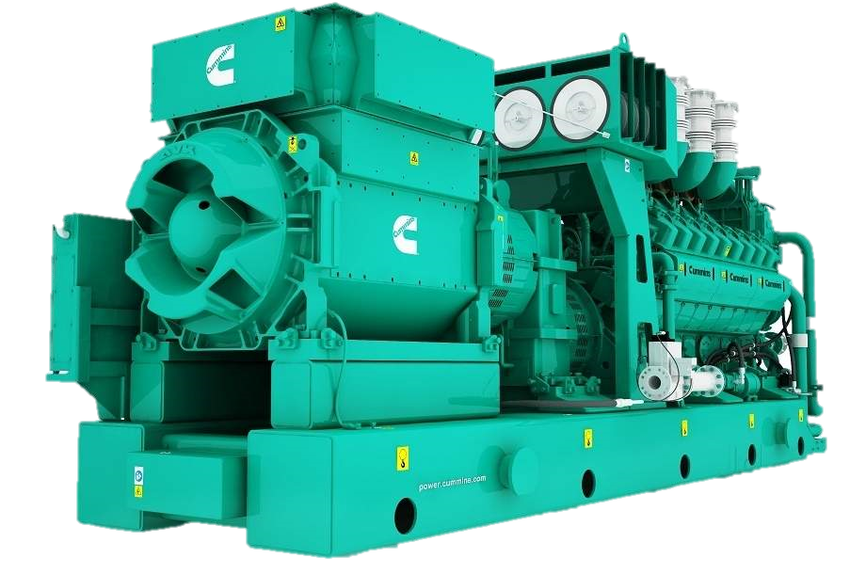
AC GENERATOR
A device changing Mechanical energy into Electrical energy.
WORKING PRINCIPLE :
Works on the principle of ELECTROMAGNETIC INDUCTION.

Slide 3

AC GENERATOR
The main components of AC generator are
- CONSTRUCTION
B
C
Armature coil
Strong magnet
N
S
Slip rings
Brushes
Iron core
Armature, strong magnets and brushes are the same as used for electric motors.
A
D
R₁
Armature coil
B₁
Slip rings : The two ends of the armature coil are connected to two brass slit rings R₁ and R₂. These rings rotate along with the armature coil
Slip rings
R₁
B₂
Axle
G

Slide 4
Drawing of AC generator
Magnetic field
N
B
C
S
A
D
B₁
R₁
Conducting
ring
Carbon
brushes
R₂
B₂
Axle
0
10
10
20
20
G

Slide 5
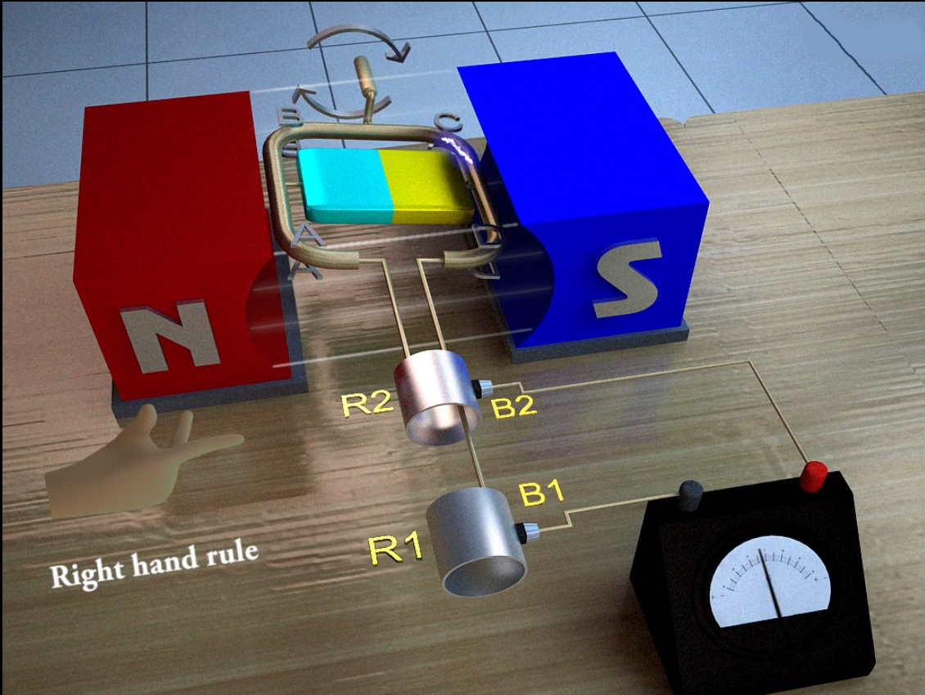
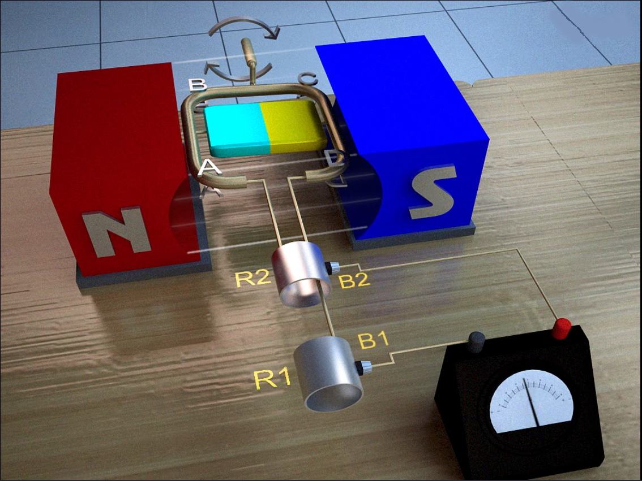
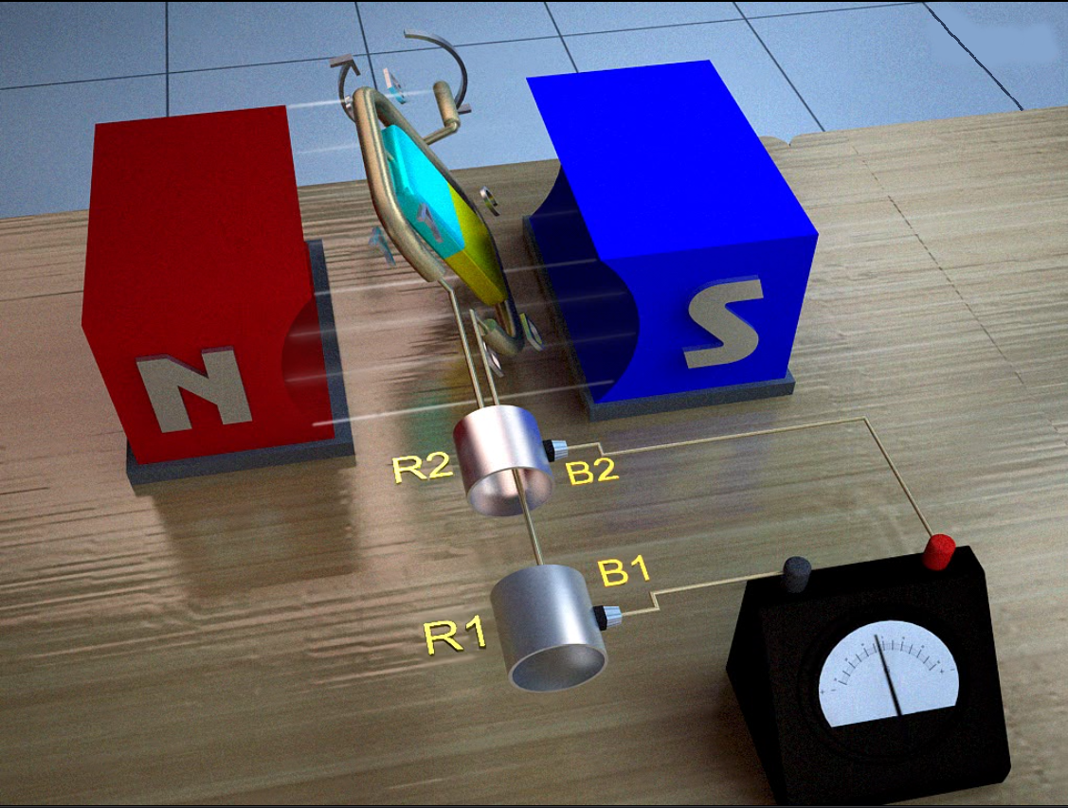
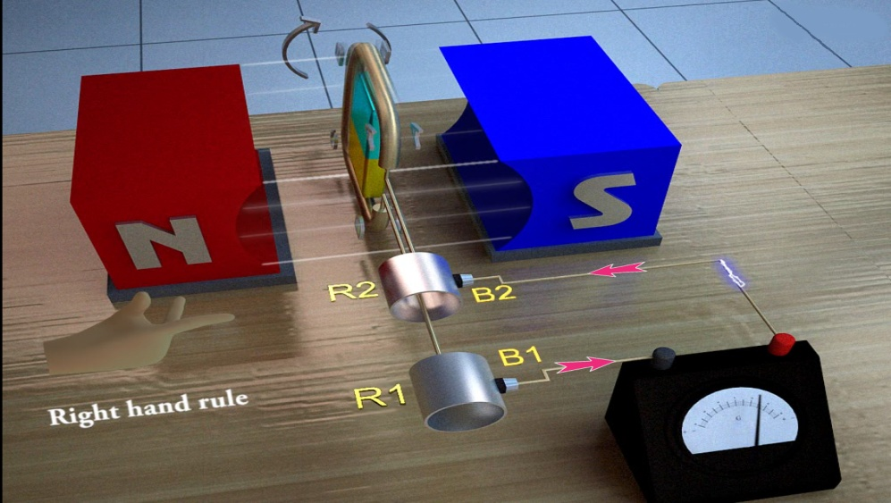
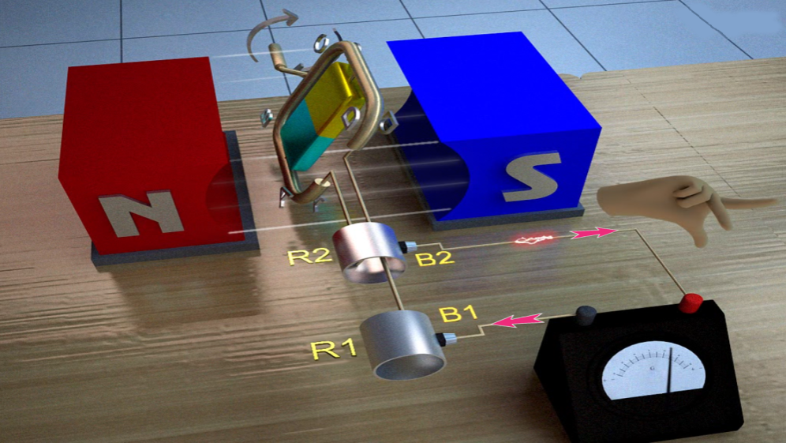
AC generator
- Working of the AC generator:
Armature coil ABCD rotates in the magnetic
It cuts the magnetic lines of forces
Produces induced current in the coil
Current flows through brush B1 in one direction in the first half of the revolution and through brush B2 in the next half revolution
The direction of induced current is determined by the fleming’s right hand rule
In the reverse direction, this process is repeated.
Therefore, the induced current produced is of alternating nature.
Such a current is called as alternating current.

Slide 6
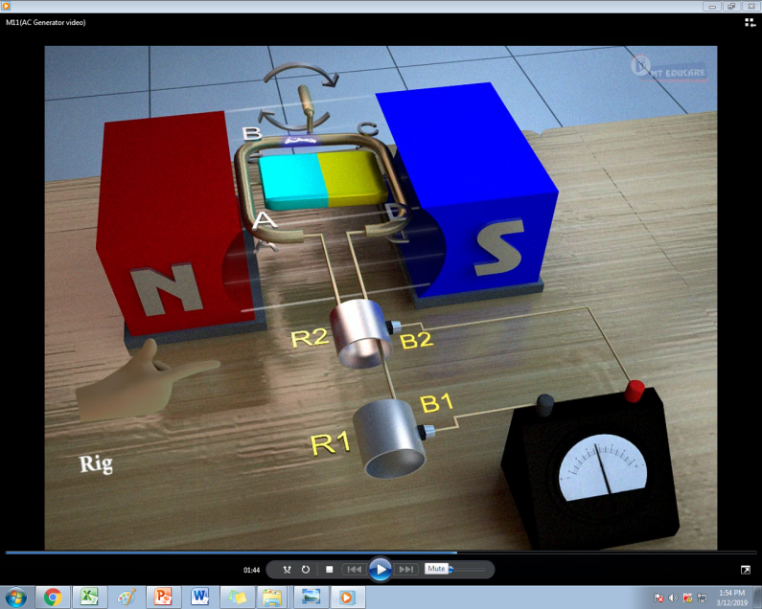
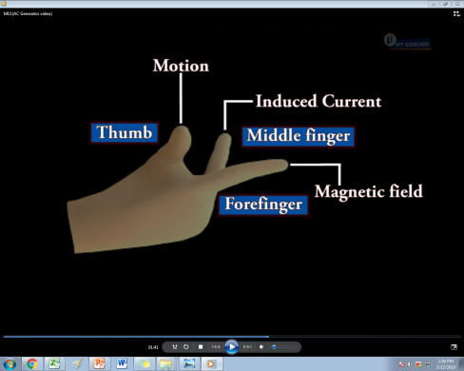
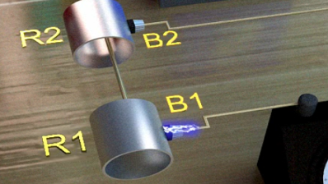
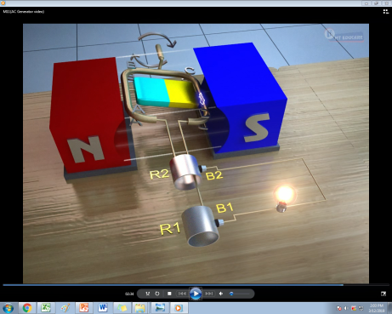
1. The armature coil is rotated in a magnetic field
2. It cuts the magnetic lines of force
3. A current is induced in the armature coil
4. The direction of induced current can be found using Flemings right hand rule
5. In the first half cycle, current flows from brush B₁ to B₂
6. In the next half cycle, current flows from brush B₂ to B₁
7. Such a current changes its direction periodically
8. The current produced is called Alternating current
9. Hence, this generator is called an AC generator

Slide 7



DC GENERATOR
(DYNAMO)
ARMATURE
SOUTH POLE
NORTH POLE
MAGNETIC FIELD
S
N
S
N
BRUSHES
COMMUTATOR
Where is the dynamo used?
0
10
10
20
20
30
G
30
GALVANOMETER

Slide 8
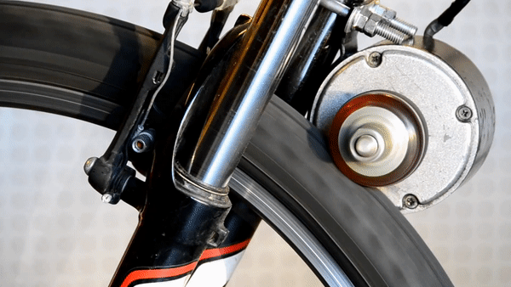
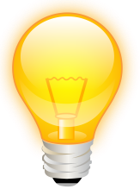

Slide 9
DC GENERATOR
S
N
S
N
This is because one brush is always in contact with the arm of the armature moving up and other brush is in contract with the arm of the armature moving downward in the magnetic field.
In DC generator, the flow of current in the circuit is in the same Direction as long as the coil rotates in the magnetic field
0
10
10
20
20
30
G
30

Slide 10

DC GENERATOR
The main components of DC generator are
- CONSTRUCTION
Armature coil
Strong magnet
B
C
N
S
Split rings or commutator
Iron core
Brushes
Bulb
D
A
The components such as armature coil, strong magnet, brushes are the same which are used for AC generators.
Armature coil
Split ring
Split rings or commutator is the same as used in electric motor.
B₁
B₂
Axle
Bulb: The output is shown by the glowing bulb connected across the carbon brushes.

Slide 11


Choose the correct option:
A rectangular coil of copper wires is rotated in a magnetic field. The direction of the induced current changes once in each
two revolutions (b) one revolution
(c) half revolution (d) one-fourth revolution
Q.
Ans.
The correct option is (c)

Slide 12
Thank You

